Slide 1
CPS 235 Object Oriented Programming Paradigm
Lecturer Rabia Khan
Filing in C++

Slide 2
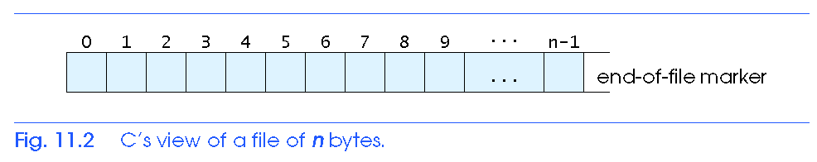
Why do we need Files?
All the programs we have looked at so far use input only from the keyboard, and output only to the screen
  Data that is held in variables is temporary and is lost when the program execution is finished
In order to store data permanently, we need to store it in files on the hard disk
The easiest way to think about a file is as a linear sequence of characters
‘W’
‘h’
‘y’
‘ ’
‘d’
‘o’
….
CPS235: FilesAndStreams

Slide 3
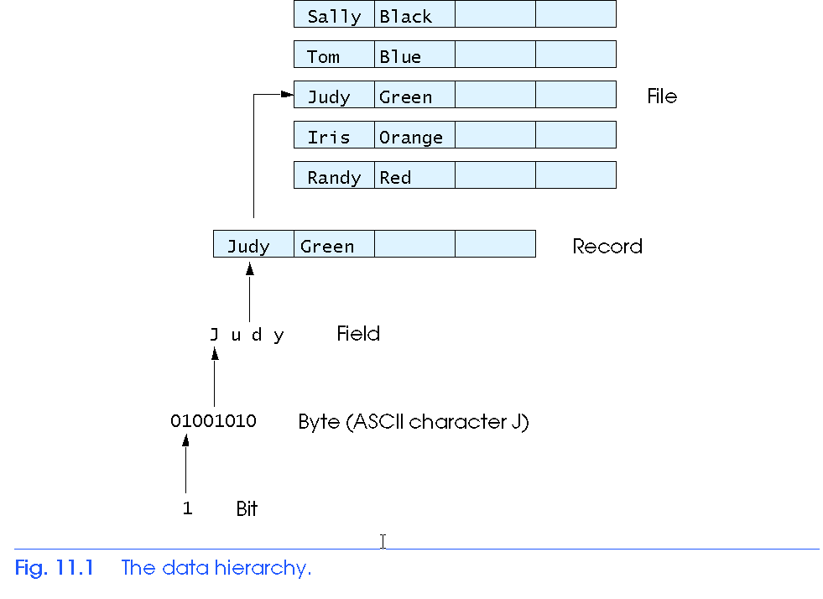
The Data Hierarchy
CPS235: FilesAndStreams

Slide 4
The Data Hierarchy
n terms of data storage, data fields are made of bytes and these in turn are made up of bits.
A data field or a field holds a single fact. Consider a date field, e.g. "September 19, 2004“
A record is a collection of related fields. An Employee record may contain a name field(s), address fields, birthdate field and so on.
A file is a collection of related records. For example a file may contains records f 100 Employees.
CPS235: FilesAndStreams

Slide 5
C++ Streams
Stream
  A transfer of information in the form of a sequence of bytes
I/O Operations
  Input stream: A stream that flows from an input device to the main memory ( from: keyboard, disk drive, scanner or network connection)
  Output stream: A stream that flows from the main memory to an output device ( to: screen, printer, disk drive or network connection)‏
CPS235: FilesAndStreams

Slide 6
Program
Output Stream
(ostream)
Input Stream (istream)
I/O Devices
CPS235: FilesAndStreams

Slide 7
Program
Output Stream
(ofstream)
Input Stream (ifstream)
File on Disk
CPS235: FilesAndStreams

Slide 8
Headers required for stream processing
  <iostream.h> (cout, cin, cerr, clog)
  <fstream.h>
    class ifstream - input from file
    class ofstream – output to file
    class fstream - either input or output from/to file
CPS235: FilesAndStreams

Slide 9
Creating Streams
Before we can use an input or output stream in a program, we must "create" it
//create an input stream
ifstream in_stream;
//create an output stream
ofstream out_stream;
CPS235: FilesAndStreams

Slide 10
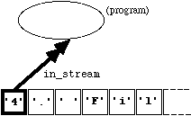
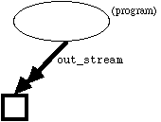
Connecting Streams to Files
Having created a stream, we can connect it to a file using the member function "open(...)”
in_stream.open(“file.txt");
out_stream.open(“file.txt");
  it also deletes the previous contents of
  the file
CPS235: FilesAndStreams

Slide 11
Creating and connecting streams to files in one statement
ifstream in_stream(“file.txt”);
ofstream out_stream(“file.txt”);
CPS235: FilesAndStreams

Slide 12
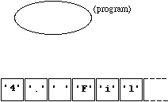
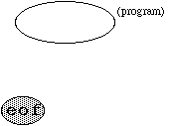
Disconnecting Streams from Files
To disconnect a stream from a file, we can use the member function “close(...)”
in_stream.close();
out_stream.close();
  Adds an "end-of-file" marker at the end of
  the file, so if no data has been output to
  “file.txt” since "out_stream" was connected
  to it, we have this situation
CPS235: FilesAndStreams

Slide 13
Checking for Failure with File Commands
void main()
{
ifstream in_stream;
in_stream.open("Lecture.txt");
if (in_stream.fail()) // or if(!in_stream)
{
cout << "Sorry, the file couldn't be opened!\n";
exit(1);
}
//....
}
CPS235: FilesAndStreams

Slide 14
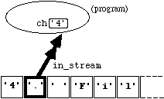
Character Input
Input using get()
we can extract or read single characters from the file using the member function "get(...)“
in_stream.get(ch); has two effects:
  the variable "ch" is assigned the value "'4'", and
  the ifstream "in_stream" is re- positioned so as to be ready to input the next character in the file.
  Diagramatically, the new situation is:
CPS235: FilesAndStreams

Slide 15
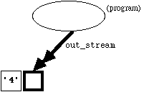
Character Output
Output using put()
We can write single characters to a file opened via an ofstream using the member function "put(...)“
out_stream.put('4'); changes the state to:
CPS235: FilesAndStreams

Slide 16
Checking for the end of an input file
The eof() function returns true if the end-of-file is reached
This function can be used in a loop to determine how many times the get() function should be called to read the complete input file
CPS235: FilesAndStreams

Slide 17
Example
Write code to copy the contents (character by character) of a file “old.txt” simultaneously to the screen and to another file “new.txt”
CPS235: FilesAndStreams

Slide 18
#include <iostream> #include <fstream>
#include <conio> #include <stdlib>
void main()
{
ifstream in_stream; //create input stream
ofstream out_stream; //create output stream
in_stream.open("old.txt"); //connect to file
if(!in_stream) //if file opening fails
{
cerr<<"file could not be opened";
exit(1);
}
out_stream.open("new.txt"); //connect to file
char character;
in_stream.get(character); //read 1 char from file
while (!in_stream.eof()) //loop till eof
{
cout << character; //display to screen
out_stream.put(character); //write to file
in_stream.get(character); //read next char
}
out_stream.close(); //disconnect stream
in_stream.close(); //disconnect stream
}
CPS235: FilesAndStreams

Slide 19
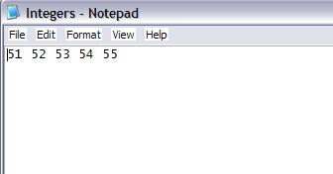
Input and output using >> and <<
void main()
{
char character;
int number = 51;
int count = 0;
ofstream out_stream;
ifstream in_stream1;
ifstream in_stream2;
/* Create the file */
out_stream.open("Integers.txt");
for (count = 1 ; count <= 5 ; count++)
out_stream << number++ << ' ';
out_stream.close();
CPS235: FilesAndStreams

Slide 20
Input and output using >> and <<
/* Count the integers in the file */
in_stream1.open("Integers.txt");
count = 0;
in_stream1 >> number;
while (!in_stream1.eof())
{
count++;
in_stream1 >> number;
}
in_stream1.close();
cout << "There are " << count << " integers in the file,\n";
CPS235: FilesAndStreams

Slide 21
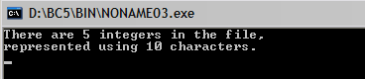
Input and output using >> and <<
/* Count the non-blank characters */
in_stream2.open("Integers.txt");
count = 0;
in_stream2 >> character;
while (!in_stream2.eof())
{
count++;
in_stream2 >> character;
}
in_stream2.close();
cout << "represented using " << count << " characters.\n";
}
CPS235: FilesAndStreams

Slide 22
Input and output using >> and <<
Another Example
void main()
{
ofstream outClientFile( "clients.dat", ios::out );
if ( !outClientFile ) {
cerr << "File could not be opened”;
exit(1);
}
cout << "Enter the account, name, and balance.\n” << "Enter end-of-file to end input.\n? ";
//contd on next slide…
CPS235: FilesAndStreams

Slide 23
Input and output using >> and <<
//…contd from previous slide
int account;
char name[ 30 ];
float balance;
while ( cin >> account >> name >> balance )
{
outClientFile << account << ' ' << name
<< ' ' << balance << '\n';
cout << "? ";
}
getch();
}
CPS235: FilesAndStreams

Slide 24
File open modes
ios:: app - (append) write all output to the end of file
ios:: ate - data can be written anywhere in the file
ios:: binary - read/write data in binary format
ios:: in - (input) open a file for input
ios::out - (output) open a file for output
ios:: trunc -(truncate) discard the files’ contents if it exists
ios::nocreate - if the file does NOT exist, the open operation fails
ios::noreplace - if the file exists, the open operation fails
CPS235: FilesAndStreams

Slide 25
File open modes (defaults)
class default mode parameter
ofstream ios::out
ifstream ios::in
CPS235: FilesAndStreams

Slide 26
fstream class
An object of fstream opens a file for reading and writing simultaneously, so we can write something like
fstream outClientFile;
int account;
char name[20];
float balance;
outClientFile.open( "clients.dat",ios::out | ios::in ); //specifying multiple modes
outClientFile>>account>>name>>balance;
cout<<account<<" "<<name<<" "<<balance;
outClientFile<<“writing something new!";
CPS235: FilesAndStreams

Slide 27
Reading and printing a sequential file
#include <iostream.h>
#include <fstream.h>
#include <iomanip.h>
#include <stdlib.h>
void outputLine( int, const char *, double );
int main()
{
// ifstream constructor opens the file
ifstream inClientFile
(“Z:\\MyFolder\\clients.dat", ios::in );
if ( !inClientFile ) {
cerr << "File could not be opened\n";
exit( 1 );
}
CPS235: FilesAndStreams

Slide 28
int account;
char name[ 30 ];
double balance;
cout << setiosflags( ios::left ) << setw(10) << "Account“ << setw( 13 ) << "Name"
<< "Balance\n";
while ( inClientFile >> account >> name >> balance )
outputLine( account, name, balance );
return 0; // ifstream destructor closes the file
}
void outputLine( int acct, const char *name, double bal )
{
cout << setiosflags( ios::left )<< setw(10) << acct << setw( 13 ) << name << setw( 7 ) << setprecision( 2 ) << resetiosflags( ios::left )<< setiosflags( ios::fixed | ios::showpoint )<< bal << '\n‘;}
CPS235: FilesAndStreams

Slide 29
Acknowledgements/Recommended Reading
http://www.doc.ic.ac.uk/~wjk/C++Intro/RobMillerL4.html
Deitel and Deitel Ch:17
CPS235: FilesAndStreams

